Slide 1
Data Scraping and Visualisation with Python
Guide: Dr. Santosh Kumar Singh|by Parth Verma, Anmol Sahni

Slide 2
Problem Statement
Lack of Analysis and visualisation when dealing with online social networking sites for working professionals seeking job opportunities.
Data scraping and visualization project can solve various problems across different domains such as Market Research and Competitor Analysis.

Slide 3
Objectives and Scope
To take user inputs from user and perform data scraping
To extract, process, and analyse data from concerned websites or other data repositoriestories.
Visualising the scraped data in the form of insights and visualisation which convey meaningful information.

Slide 4

User Input

Slide 5
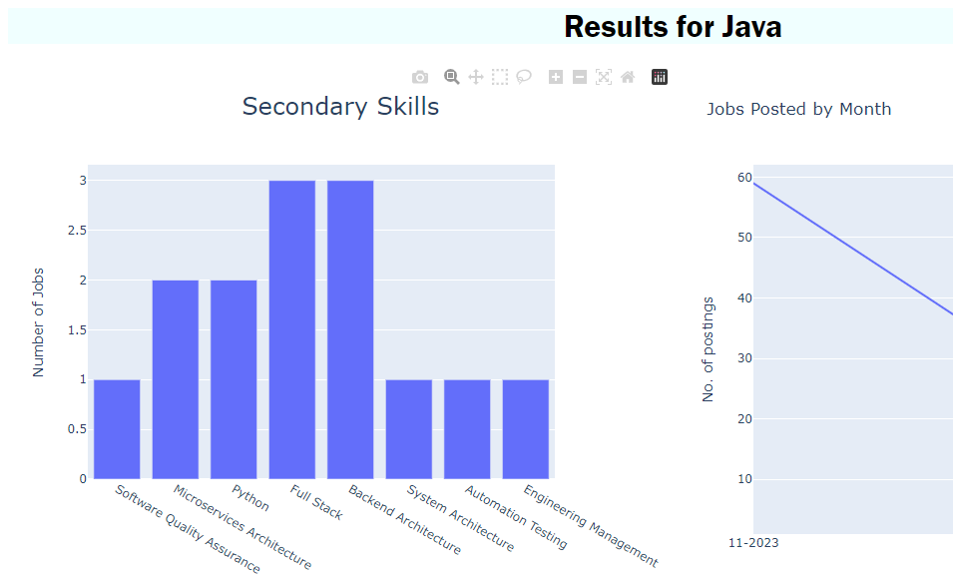
Derived Insights

Slide 6
Methodology
Data Scraping: Scraping data from websites and storing it.
Data Processing: Clean, transform, and structure the raw data for analysis.
Data Analysis: Extract meaningful insights, trends, patterns, and correlations from the data.
Data Visualization: Present the analysed data in a visual format that is easy to understand and interpret.
Decision Support: Enable users to make informed decisions based on the visualized data and insights.
Automation: Streamline the process of data collection, analysis, and visualization through automation, where applicable.

Slide 7
Hardware and Software Used
Hardware Requirements:
RAM: 8 Gb minimum
Storage: 50 Gb minimum
Internet speed over 100mbps

Slide 8
Hardware and Software Used
Software Requirements:
Operating system platform
Web Browser
SQL server
Programming languages – Python
Scraping libraries - Beautiful Soup
Data analysis tools –Matplotlib, Plotly , Pandas, NumPy, Collections, Plotly
Framework Support: Django
IDEs: Python IDE

Slide 9
Conclusion
The data scraping and visualization project aims to empower users with valuable insights from diverse data sources.
By following systematic manual testing methodologies, we can ensure the accuracy, functionality, and user-friendliness of the application and visualizations.
Provides a powerful tool for informed decision-making, efficient data analysis, and enhanced user experiences.

Slide 10
THANK YOU

